Slide 1

Unified Home Study
General Information
Office of Child welfare
April/May 2018

Slide 2

Learning Objectives
Define the purpose of a Unified Home Study (UHS) and explain why changes have been made to policies and FSFN functionality.
Examine the common core components of a UHS and the information gathered to assess these components.
Identify new FSFN functionality and how it relates to the various UHS types.
Unified Home Study 1.2

Slide 3
Unified Home Study Definition
The Unified Home Study (UHS) is the assessment of a common set of requirements that must be met before the child is placed by a Child Welfare Professional into someone’s home, such as a relative/non-relative, foster family, or adoptive family.
Unified Home Study 1.3

Slide 4
Why Change?
UHS FSFN functionality did not align with practice and policy.
UHS FSFN functionality and state policies did not align with post-Title IV-E Waiver requirements.
The UHS is not user-friendly and does not meets the needs of Child Welfare Professionals.
Unified Home Studies are not consistently approved and denied in FSFN.
Unified Home Study 1.4

Slide 5
What Has Changed?
Policies:
65C-16, F.A.C.: Adoptions
65C-13, F.A.C.: Licensing
65C-28, F.A.C.: Out-of-Home Care
CFOP 170-1, Chapter 5: Unified Home Study
CFOP 170-1, Chapter 6: Requesting and Analyzing Background Records
Unified Home Study 1.5

Slide 6
What Has Changed?, con’t.
FSFN Functionality:
Ability to inactivate
non-household members
Ability to build upon a previously approved UHS
Redesign of the finance breakdown group box
Modification of the narrative family assessment
Modification of approvals process
Ability to capture common core assessment questions
Ability to search for person provider inquiries
Ability to answer non-required questions
Creation of a provider filing cabinet and a provider licensing checklist
Unified Home Study 1.6

Slide 7
When Do the Changes Occur?
FSFN Enhancements are scheduled to go live June 15, 2018!
Unified Home Study 1.7

Slide 8
Resources
The following materials can be found here:
http://www.centerforchildwelfare.org/HomeStudy.shtml
UHS Train-the-Trainer Guides, PowerPoints, and
Participant Guides
UHS Job Aid
FSFN Tutorials
UHS FSFN Functionality Informational Flyers
Unified Home Study 1.8

Slide 9
Resources, con’t.
The following materials can be found here:
http://centerforchildwelfare.fmhi.usf.edu/DeptOperatingProcedures.shtml
CFOPs
The following materials can be found here:
http://centerforchildwelfare.fmhi.usf.edu/FloridaAdminCode.shtml
Florida Administrative Codes
Unified Home Study 1.9

Slide 10
Resources, con’t.
The following materials can be found here:
http://www.centerforchildwelfare.org/FSFNAll.shtml
Unified Home Study User Guide
Unified Home Study How Do I Guide
Unified Home Study Position Paper
Unified Home Study 1.10

Slide 11
Placement Assessment
A Placement Assessment must be completed when a child is initially removed. Additional Placement Assessments should be completed as determined by the Community Based Care (CBC) Lead Agency.
The placement assessment helps determine the level of care needed for each child placed in out-of-home care to ensure the most appropriate placement is selected
on behalf of the child.
When the needs and preferences of the child are assessed, Child Welfare Professionals are then able to make the BEST possible match
for the child.
Unified Home Study 1.11

Slide 12

FSFN Tutorial
Purpose of the
Unified Home Studies
Unified Home Study 1.12

Slide 13
Purpose of Unified Home Studies
Emergency Placement
Initial License or
Re-license for
Foster Home
Adoption
Addendum
Relative/
Non-relative Placement
Adoption
Addendum-Not Adoption
Unified Home Study 1.13

Slide 14

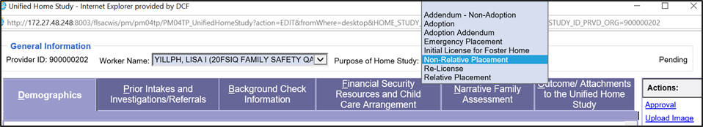

FSFN Screens
How to select the purpose of the homestudy
Unified Home Study 1.14

Slide 15
Person Provider Inquiry
The Person Provider Inquiry is used to document the initial inquiry when a potential caregiver wants to become a Person Provider (i.e., licensed foster parent, relative or non-relative caregiver, or adoptive parent).
Unified Home Study 1.15

Slide 16
What Has Changed with the Person Provider Inquiry?
Person Provider Inquiry:
  Household members and non-household members are not able to be removed from the Person Provider Inquiry if information is captured on the UHS to ensure a clean audit trail.
  Now reflects the Person ID for household members and non-household members.
  New tab labeled Person Provider Inquiry added to the existing Search page accessed from the banner bar by selecting the Search command button.
Unified Home Study 1.16

Slide 17
What Has Changed with the Person Provider Inquiry?, con’t.
Person Provider:
  The links for household members have been updated so the user can more readily access Person Management and make modifications as needed.
  Household members cannot be removed or inactivated on a pending UHS.
  Non-household members can be inactivated.
  The Caregiver 1’s Person Management page has been updated.
Unified Home Study 1.17

Slide 18
FSFN Tutorial
Creating the Provider Inquiry and Launching the UHS
Unified Home Study 1.18

Slide 19

Creating the Person Provider Inquiry and Launching the UHS
How to….
Where to….
What…
Unified Home Study 1.19

Slide 20
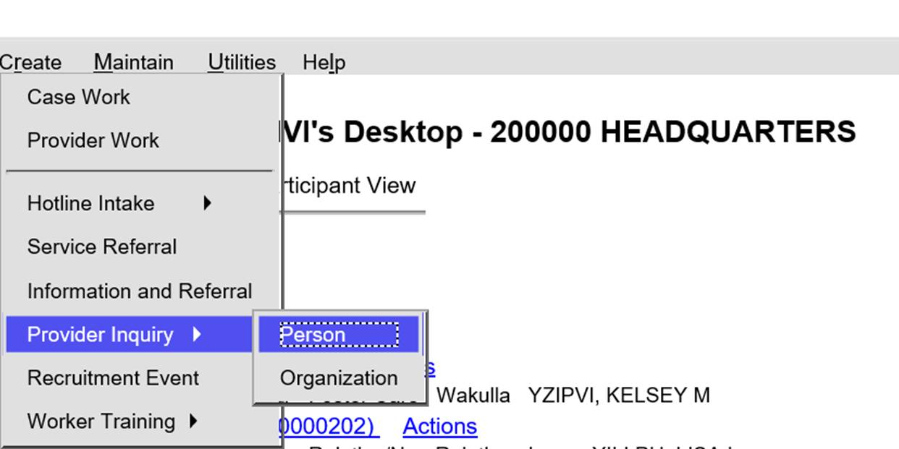
FSFN Screens
How to create a Person Provider Inquiry
Unified Home Study 1.20

Slide 21
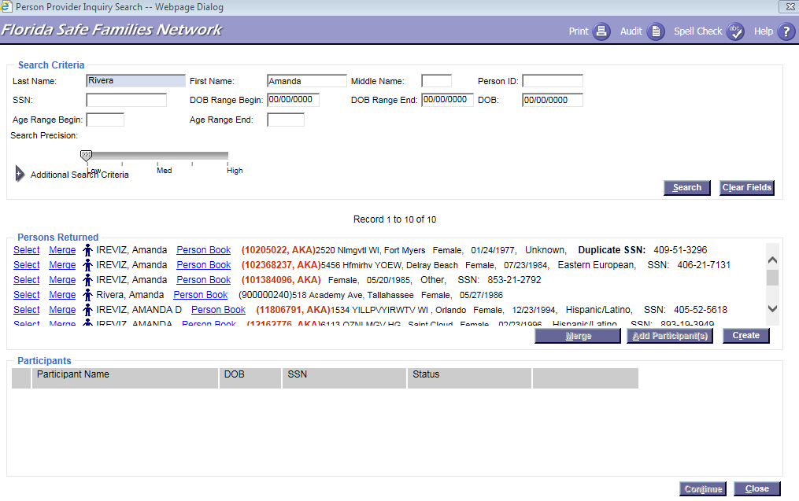
FSFN Screens
How to search and add participants to the Person Provider Inquiry
Unified Home Study 1.21

Slide 22
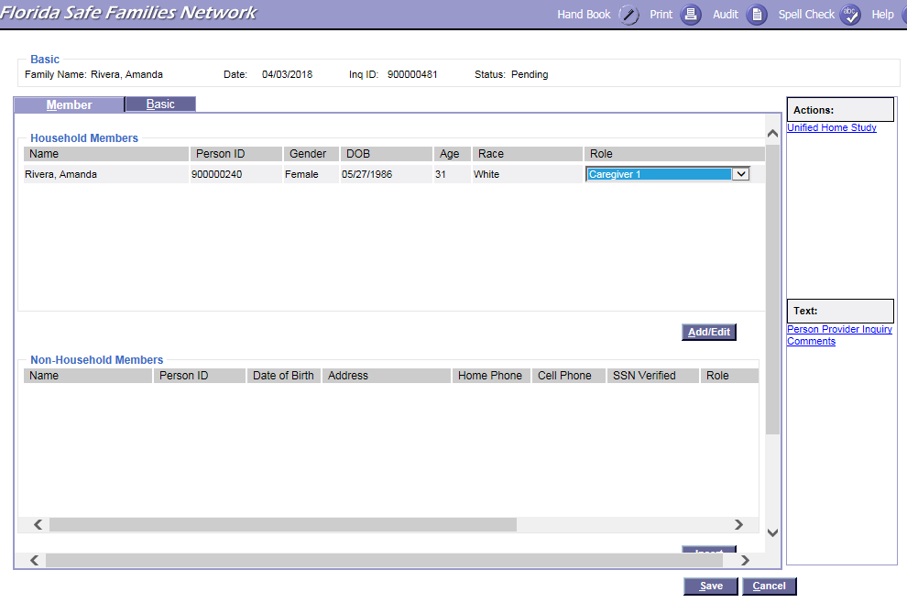
FSFN Screens
Documenting the caregiver role on the Person Provider Inquiry page
Unified Home Study 1.22

Slide 23
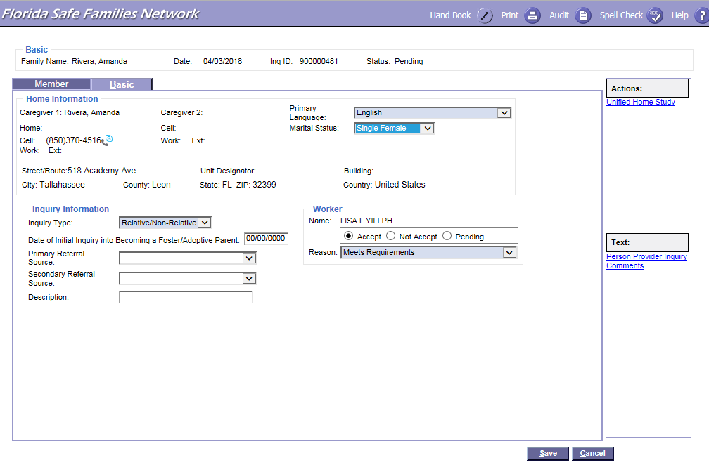
FSFN Screens
Where to complete the acceptance decision
Unified Home Study 1.23

Slide 24
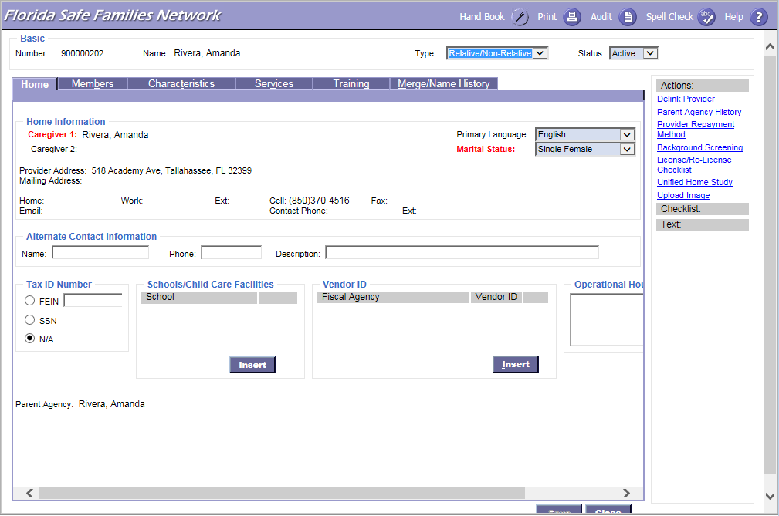
FSFN Screens
What the Person Provider Home tab looks like once created
Unified Home Study 1.24

Slide 25
FSFN Screens
Launching the UHS from a
Person Provider page
Unified Home Study 1.25

Slide 26
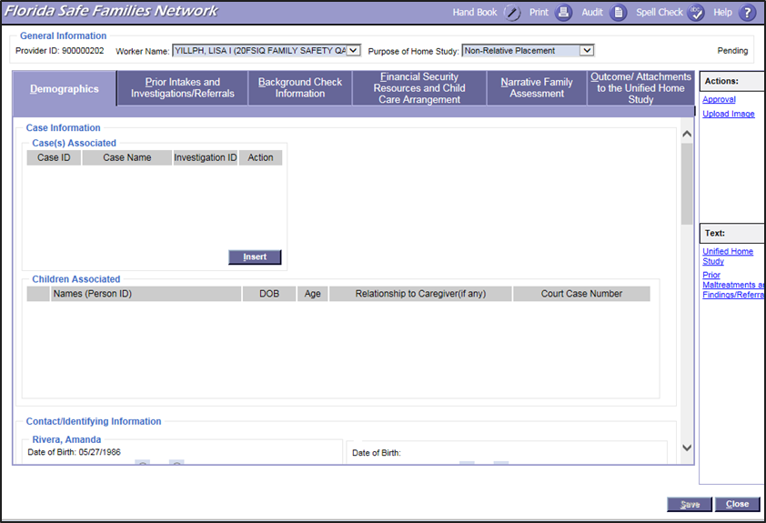
FSFN Screens
UHS Main page once created
Unified Home Study 1.26

Slide 27

FSFN Screens
How to link the UHS with a particular
FSFN case
Unified Home Study 1.27

Slide 28
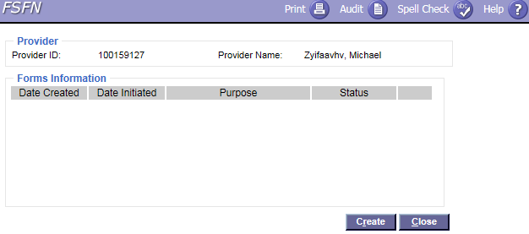
FSFN Screens
How to link the UHS with a particular
FSFN case
Unified Home Study 1.28

Slide 29
FSFN Tutorial
Provider File Cabinet
Unified Home Study 1.29

Slide 30

Provider File Cabinet
The new Provider File Cabinet allows Child Welfare Professionals to upload documents that relate specifically to the provider.
Unified Home Study 1.30

Slide 31
Provider File Cabinet, con’t.
  The Provider File Cabinet Image can be created directly from the Person Provider, Organization Provider, UHS, or Create Provider Work.
  Child Welfare Professionals have the ability to select a specific category.
Unified Home Study 1.31

Slide 32
Provider File Cabinet, con’t.
Provider Cabinet Search:
  This is a new page accessed from the Utilities menu on the desktop labeled Provider File Cabinet Search.
  Search criteria is available for Provider File Cabinet Search.
  Images Returned group box provides for sorting and the ability to access the Provider (Person or Organization) and Imaging page directly.
  Once the document is uploaded and titled,
  the title cannot change.
Unified Home Study 1.32

Slide 33
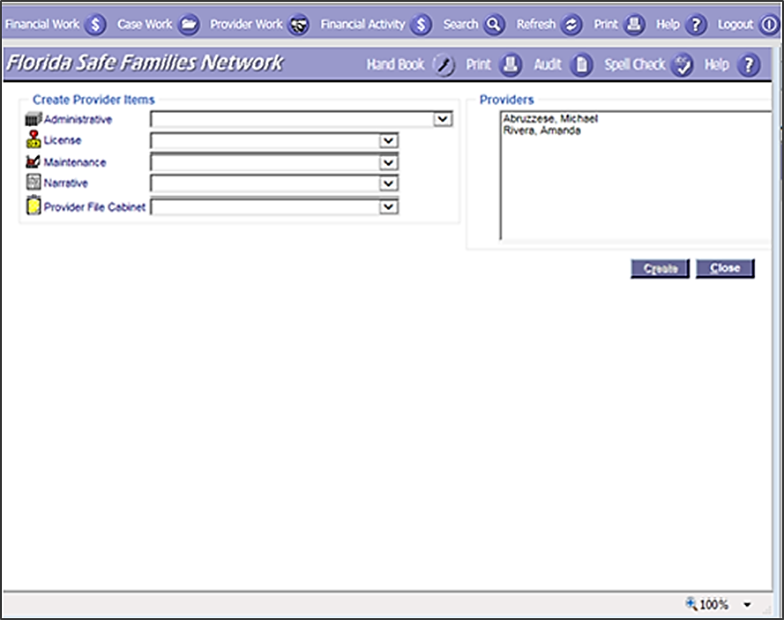
FSFN Screens
How to access the Provider File Cabinet
Unified Home Study 1.33

Slide 34
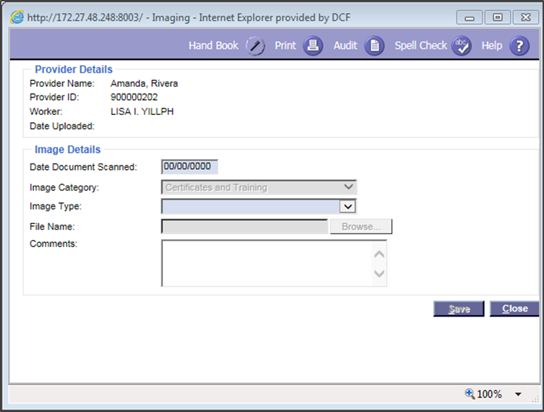
FSFN Screens
How to upload the Image pop-up box for the Provider File Cabinet
Unified Home Study 1.34

Slide 35
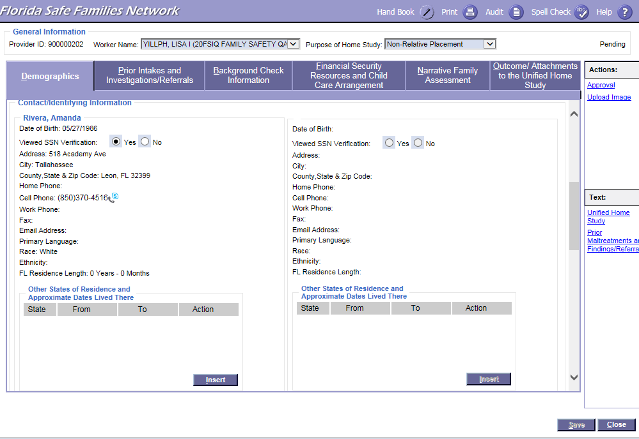
FSFN Screens
How to upload images from the UHS
Unified Home Study 1.35

Slide 36
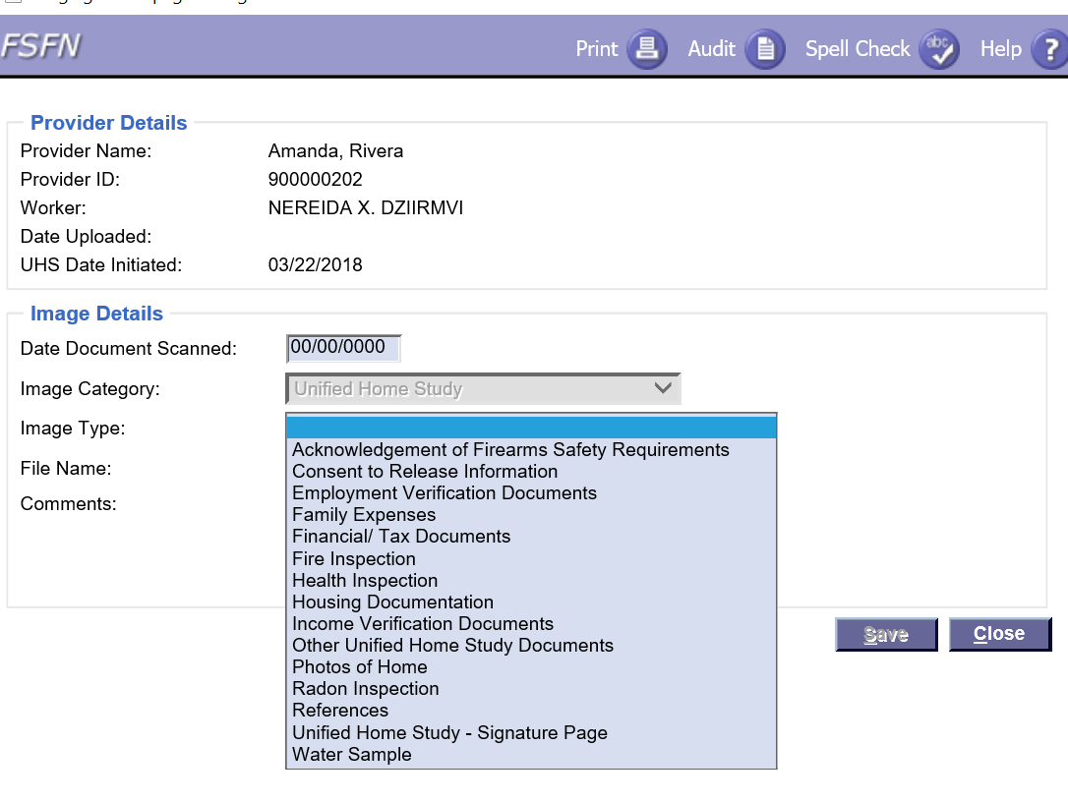
FSFN Screens
How to choose the image type
from the UHS
Unified Home Study 1.36

Slide 37
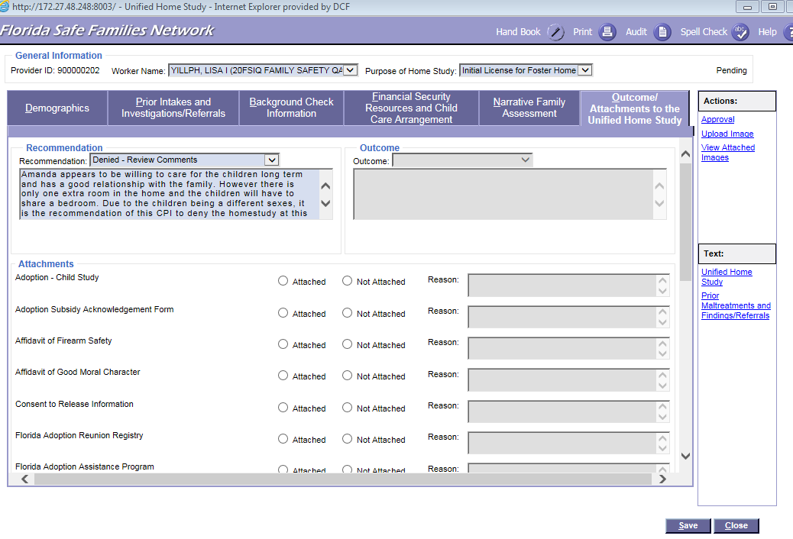
FSFN Screens
How to view attached images
from the UHS
Unified Home Study 1.37

Slide 38
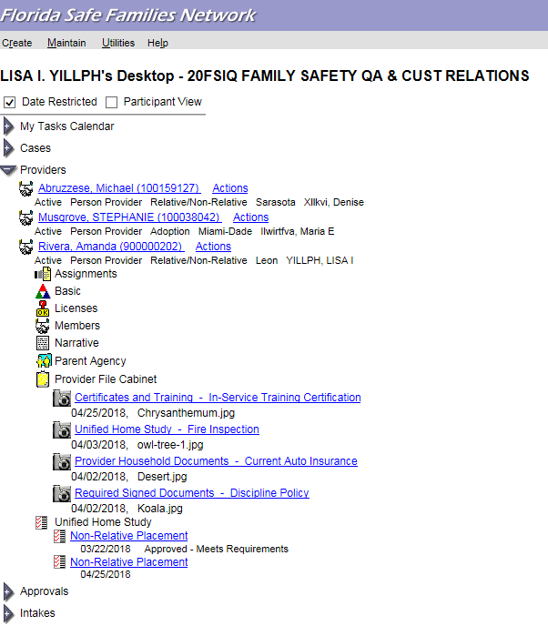
FSFN Screens
How to view attached images from the desktop
Unified Home Study 1.38

Slide 39
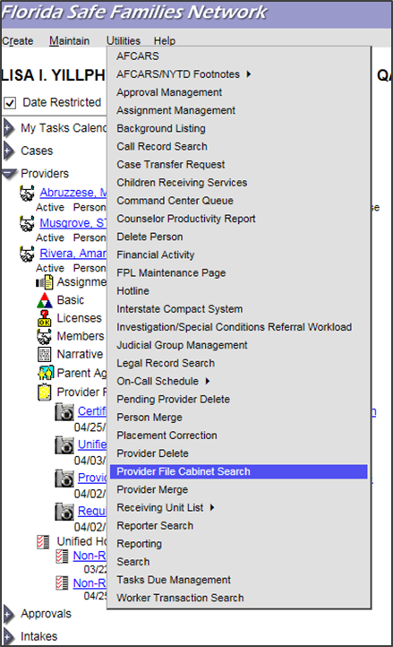
FSFN Screens
How to serach in the Provider File Cabinet
Unified Home Study 1.39

Slide 40
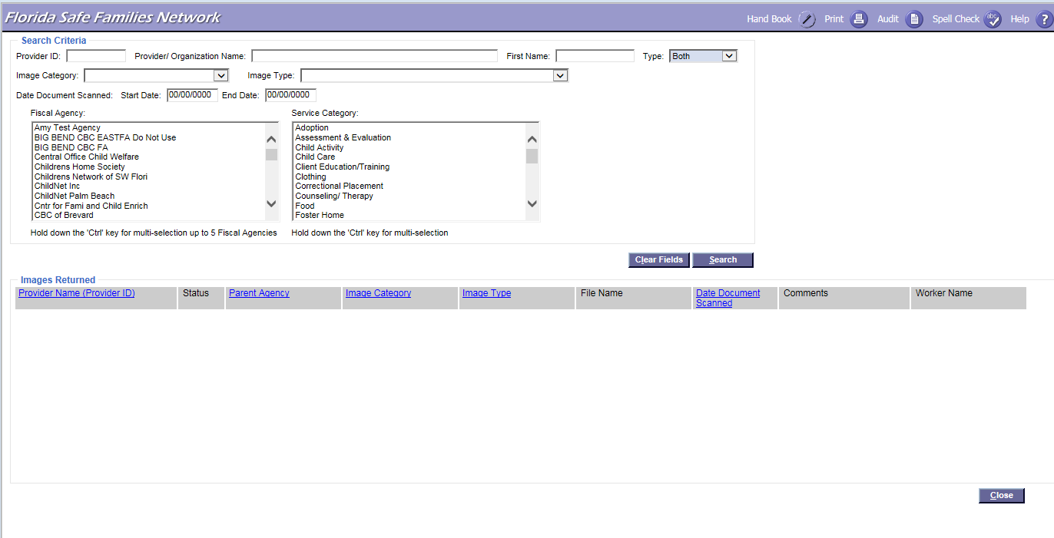
FSFN Screens
How to search in the Provider File Cabinet
Unified Home Study 1.40

Slide 41
What Components Does a
Unified Home Study Assess?
Vital information to assess if identified caregiver(s) have the capacity to provide a nurturing, caring, and safe environment
Core assessment information and/or questions
Unified Home Study 1.41

Slide 42
FSFN Tutorial
Core Components
Unified Home Study 1.42

Slide 43
Core Components
Demographics
Financial Security, Resources, and Child Care Arrangements
Narrative Family Assessment
Prior Intakes and Investigations
Outcome/ Attachments
Background History
Unified Home Study 1.43

Slide 44
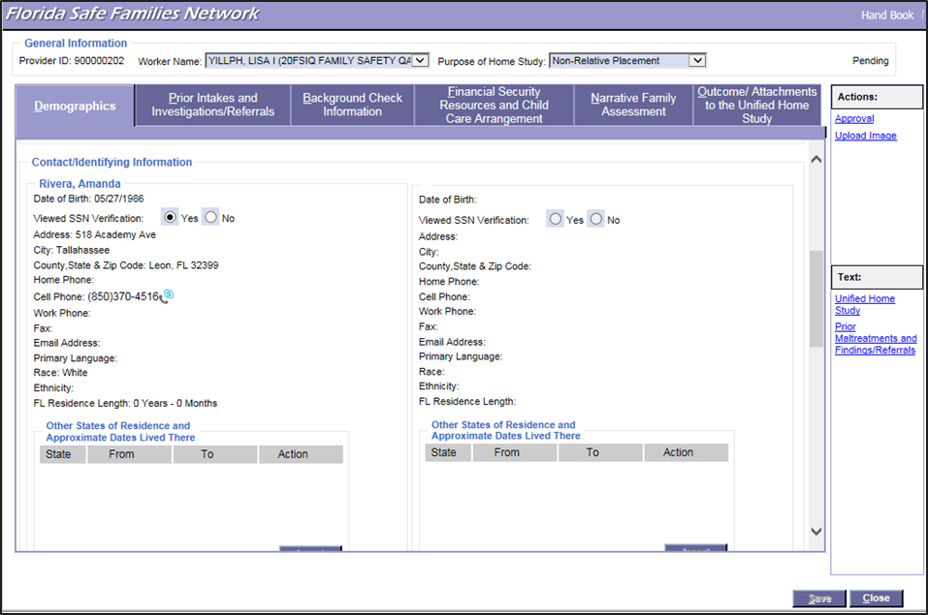
FSFN Screens
Core Component - Demographics
Unified Home Study 1.44

Slide 45
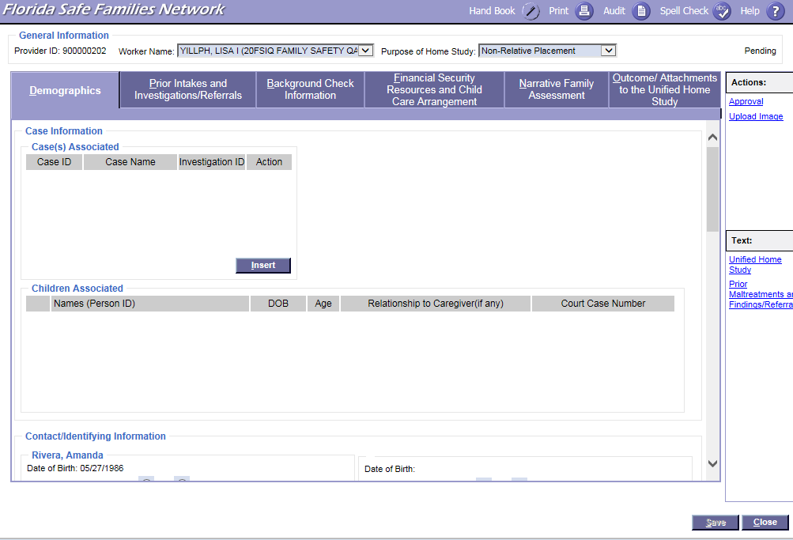
FSFN Screens
Core Component - Demographics
Unified Home Study 1.45

Slide 46
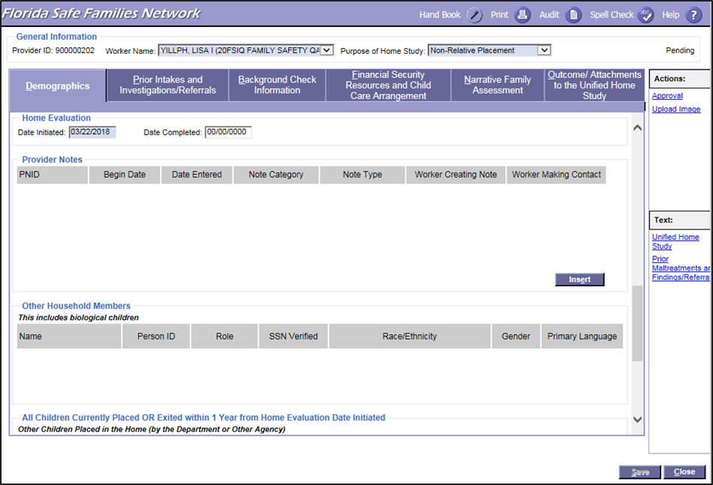
FSFN Screens
Core Component - Demographics
Unified Home Study 1.46

Slide 47
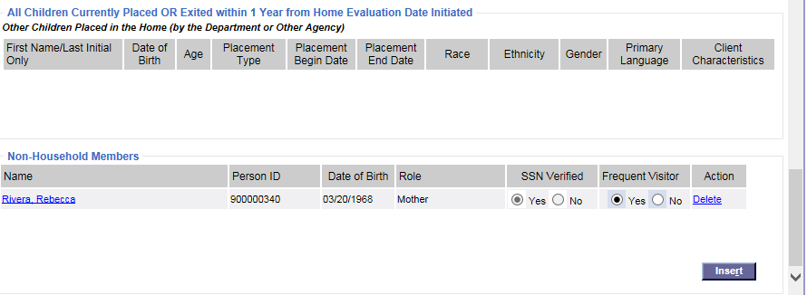
FSFN Screens
Core Component - Demographics
Unified Home Study 1.47

Slide 48
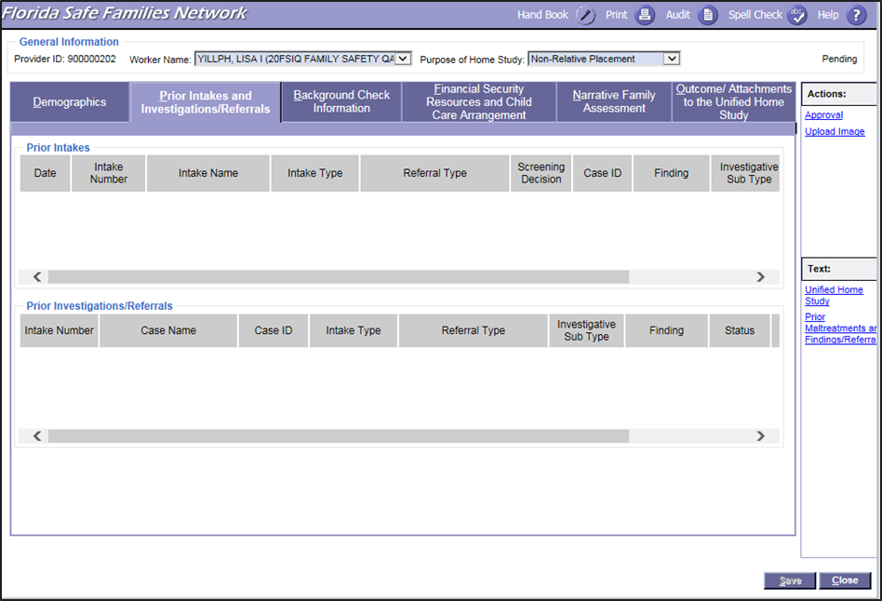
FSFN Screens
Core Component – Prior Intakes and Investigations/Referrals
Unified Home Study 1.48

Slide 49
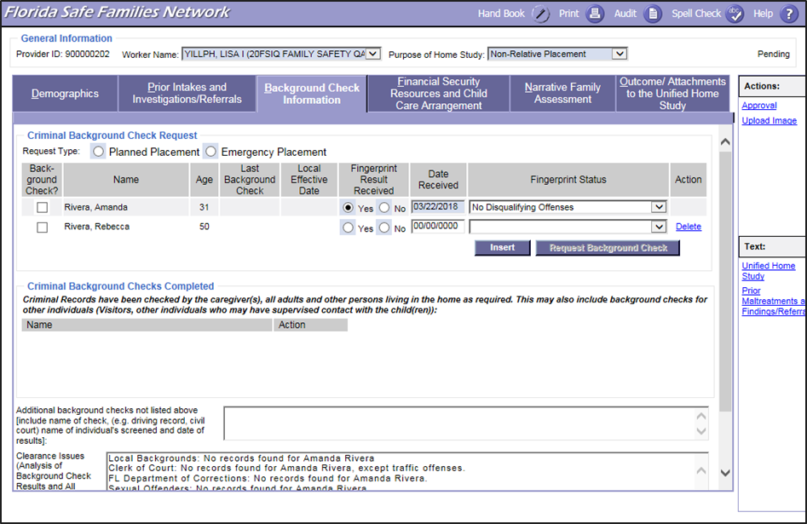
FSFN Screens
Core Component – Background
Check Information
Unified Home Study 1.49

Slide 50
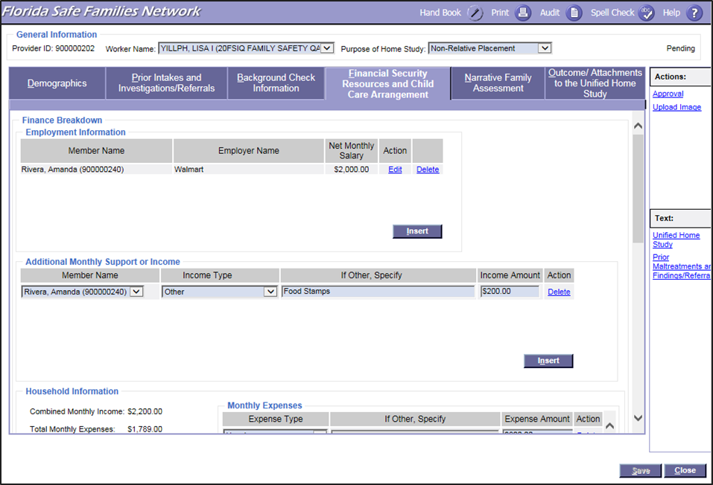
FSFN Screens
Core Component – Financial Security Resources and Child Care Arrangement
Unified Home Study 1.50

Slide 51
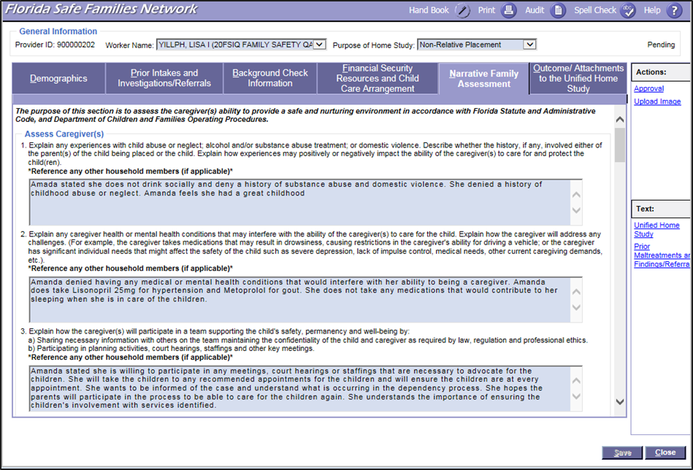
FSFN Screens
Core Component – Narrative
Family Assessment
Unified Home Study 1.51

Slide 52
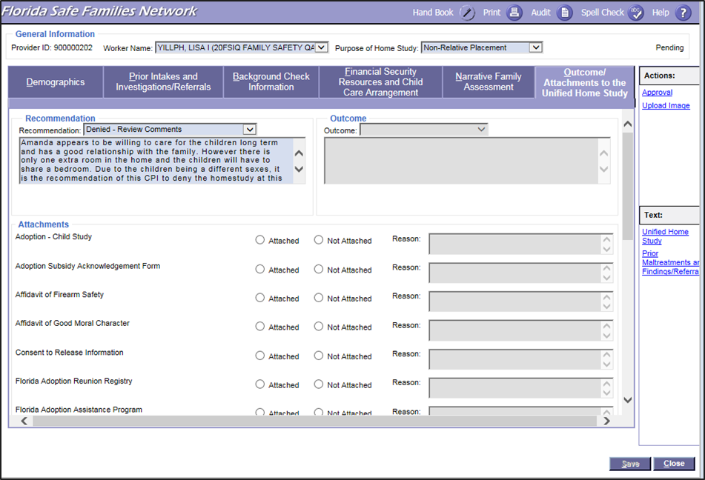
FSFN Screens
Core Component – Outcome/Attachments
Unified Home Study 1.52

Slide 53

Questions

